Slide 1
Keylogger
CAPSTONE PROJECT
Presented By:
Vasumathy.V (2021115118) - College Of Engineering, Guindy, Anna University-Department Of Information Science and Technology

Slide 2
OUTLINE
Problem Statement
Proposed System/Solution
System Development Approach
Algorithm & Deployment
Result
Conclusion
Future Scope
References

Slide 3
Problem Statement
In today's digital age, where cybersecurity threats loom large, one of the significant concerns is the proliferation of keyloggers, stealthy software tools designed to monitor and record keystrokes on a user's computer without their knowledge. Keyloggers pose a severe threat to individuals and organizations as they can capture sensitive information such as passwords, credit card details, and other personal data, leading to identity theft, financial loss, and privacy breaches.

Slide 4
Proposed Solution
Monitoring Keystrokes:
The application is designed to capture three types of keyboard events: key press, key hold, and key release. This comprehensive approach ensures that all keystrokes are recorded accurately, providing detailed insights into user activities.
Data Logging:
Captured keystrokes are stored in two formats: a text file ('key_log.txt') and a JSON file ('key_log.json'). This dual logging mechanism offers flexibility and compatibility with different data processing and analysis tools.
Graphical User Interface:
The tkinter library is employed to create a user-friendly interface for the keylogger application. The GUI includes two buttons for starting and stopping the keylogging process, along with a label to display the current status of the keylogger.
Real-Time Monitoring:
The application operates in real-time, meaning it continuously monitors keyboard events as they occur. Users can start and stop the keylogger at their convenience, providing flexibility in data collection and analysis.
Security Considerations:
The keylogger application is developed with security considerations in mind. It operates locally on the user's system and does not transmit captured data over the network, minimizing the risk of unauthorized access or data breaches.

Slide 5
Proposed Solution
6. Customization Options:
The application can be easily customized to meet specific requirements or preferences. Users have the option to modify the logging format, adjust event detection parameters, or integrate additional features for enhanced functionality.
7. Cross-Platform Compatibility:
The Python programming language ensures cross-platform compatibility, allowing the keylogger application to run on various operating systems, including Windows, macOS, and Linux.
8. Ethical Use and Legal Compliance:
It's essential to emphasize the ethical use of the keylogger application and ensure compliance with relevant laws and regulations regarding privacy and data protection. Users should obtain proper consent before deploying the keylogger and adhere to ethical guidelines for monitoring and analyzing captured data.
By implementing the proposed solution, users can effectively monitor and log keyboard activities on their computer systems, providing valuable insights for security monitoring, forensic investigations, parental control, and other legitimate purposes. The flexibility, reliability, and security features of the keylogger application make it a valuable tool for enhancing cybersecurity measures and promoting responsible use of monitoring technologies.

Slide 6
System Approach
The system development approach for the keylogger application involved the utilization of specific technologies and libraries within the Python ecosystem. These technologies facilitated the creation of a robust system capable of capturing and logging keyboard events effectively:
1. Python Programming Language:
- Python was chosen for its simplicity, versatility, and extensive libraries, allowing for rapid development and easy maintenance.
2. tkinter Library for GUI:
- tkinter provided essential tools for building a user-friendly interface, including windows, buttons, and labels, due to its simplicity and ease of use.
3. pynput Library for Keyboard Monitoring:
- pynput enabled accurate monitoring of keyboard events in real-time, abstracting low-level details of keyboard input seamlessly.
4. JSON Serialization for Data Storage:
- JSON format was used for storing captured keystrokes due to its lightweight and human-readable nature, facilitated by Python's json module.
5. File I/O Operations:
- Python's built-in file I/O functionalities were used for writing keystroke data to text and JSON files efficiently.
6. Cross-Platform Compatibility:
- Python's inherent cross-platform compatibility ensured seamless operation on various operating systems without requiring platform-specific modifications.

Slide 7
Algorithm & Deployment
Algorithm:
The keylogger application continuously monitors keyboard events using the pynput library.
When a key is pressed, the application registers it as a "Pressed" event and adds the corresponding key to the keystroke log.
If a key is held down, the application records it as a "Held" event, ensuring that all keystrokes are accurately captured.
Upon releasing a key, the application logs it as a "Released" event and adds it to the keystroke log.
The captured keystrokes are stored in memory and periodically saved to both a text file ('key_log.txt') and a JSON file ('key_log.json') for persistence.

Slide 8
Algorithm & Deployment
2. Deployment:
The keylogger application is deployed as a standalone executable or script on the target system.
Users can start the keylogger by executing the Python script or launching the executable file.
The application operates in the background, discreetly capturing keyboard events without interfering with the user's normal activities.
Users have the option to start and stop the keylogger as needed using the provided GUI buttons, ensuring flexibility and convenience.
Upon stopping the keylogger, users can access the generated text and JSON log files to review captured keystrokes and analyze user activities.
The deployment process is designed to be simple and intuitive, allowing users to deploy and utilize the keylogger application with ease.
By implementing this algorithm and deployment strategy, the keylogger application effectively captures and logs keyboard events while ensuring seamless integration and usability on the target system. Users can deploy the application effortlessly and obtain valuable insights into user activities for various purposes, including security monitoring and forensic investigations.

Slide 9
Result
When the keylogger application is executed, it operates in the background, continuously monitoring keyboard events in real-time. The output and results of the code execution can be observed in several aspects:
1. GUI Display:
- Upon execution, a graphical user interface (GUI) window is displayed, providing users with options to start and stop the keylogging process.
- The GUI window includes a label indicating the current status of the keylogger, which initially prompts users to click "Start" to begin keylogging.
2. Keylogging Process:
- Once the user clicks the "Start" button, the keylogger begins capturing keyboard events, including key presses, holds, and releases.
- As the user interacts with the keyboard, the keylogger logs each keystroke in real-time, storing the data internally in memory.
3. Status Updates:
- The GUI label dynamically updates to inform the user that the keylogger is running, indicating that keystrokes are being recorded.
- Users receive real-time feedback through the GUI, providing assurance that the keylogger is actively capturing keyboard events.
4. Logging Files:
- As the keylogger operates, it simultaneously writes the captured keystrokes to two output files: a text file ('key_log.txt') and a JSON file ('key_log.json').
- These logging files contain a chronological record of all keystrokes captured during the keylogging session, including details such as the type of event (press, hold, release) and the corresponding key.

Slide 10
Result
5. User Interaction:
- Users have the option to stop the keylogging process at any time by clicking the "Stop" button on the GUI.
- Upon stopping the keylogger, the GUI label updates to indicate that the keylogger has been halted, providing confirmation to the user.
6. Accessing Logged Data:
- After the keylogging session concludes, users can access the generated text and JSON logging files to review the captured keystrokes.
- The logging files contain comprehensive data on user keyboard activities, facilitating further analysis or investigation as needed.
Overall, the keylogger application provides users with a reliable means of capturing and logging keyboard events, offering valuable insights into user activities and enhancing cybersecurity measures. The clear feedback provided through the GUI, coupled with the comprehensive logging functionality, ensures that users can effectively monitor and analyze keyboard interactions on their computer systems.

Slide 11
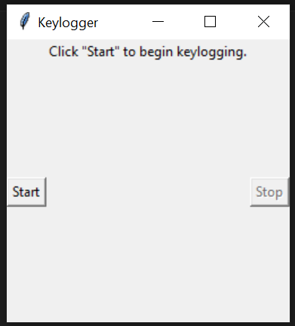
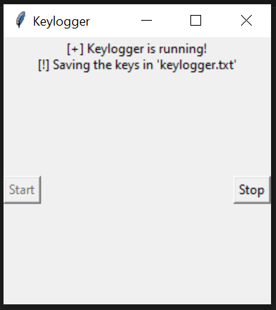
Result
Image 1 : The GUI display when code is first executed
Image 2 : The GUI display after “Start” button is pressed.

Slide 12
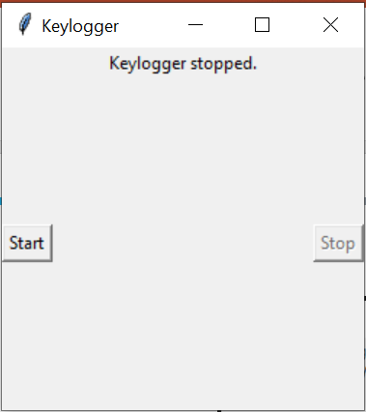
Result
Image 3 : The GUI display after “Sop” button is pressed.

Slide 13
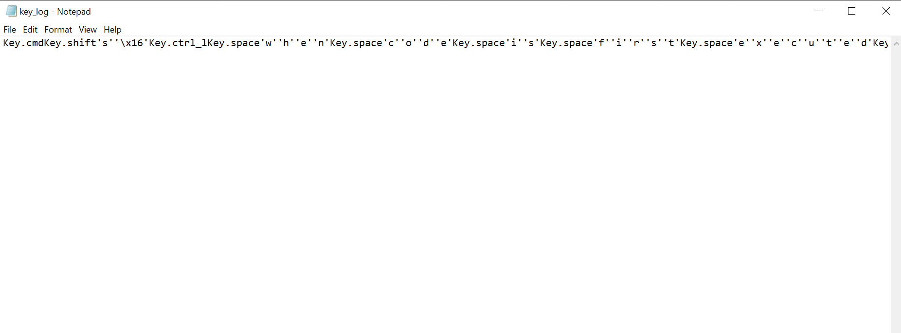
Result
Image 4: Contents of key_log.txt file after typing in keypad while the keylogger is running

Slide 14
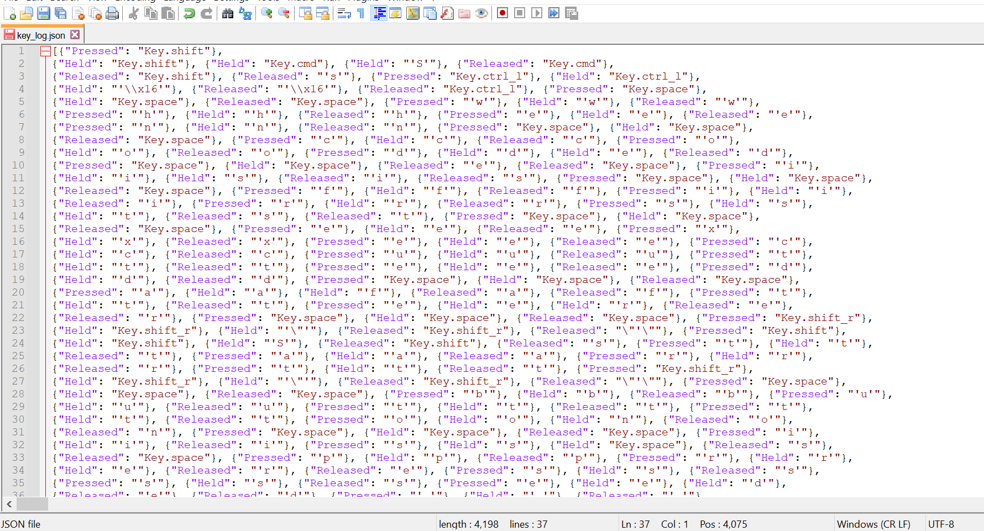
Result
Image 5: Contents of key_log.json

Slide 15
Conclusion
The development of the keylogger application represents a significant step towards enhancing cybersecurity measures and monitoring user activities on computer systems. By leveraging Python and associated libraries such as tkinter and pynput, the application efficiently captures and logs keyboard events in real-time. The user-friendly graphical interface, coupled with the comprehensive logging functionality, offers users a convenient and effective means of monitoring and analyzing keyboard interactions. While the keylogger application has legitimate uses for security monitoring and forensic investigations, it is essential to emphasize the importance of ethical use and compliance with privacy laws and regulations. Moving forward, the keylogger application serves as a valuable tool for enhancing cybersecurity awareness and promoting responsible use of monitoring technologies.

Slide 16
Future scope
Enhanced Logging Features:
- Further development of the keylogger application could involve implementing advanced logging features to provide more comprehensive insights into user activities. This may include adding timestamps to recorded keystrokes to precisely track the timing of user interactions. Additionally, capturing window titles associated with keystrokes can offer context about the applications or websites being accessed. Furthermore, incorporating mouse movement tracking can complement keyboard logging, providing a more holistic view of user behavior and interactions.
2. Remote Monitoring Capabilities:
- The keylogger application can be expanded to include remote monitoring capabilities, allowing users to monitor keyboard activities on multiple systems from a centralized location. By developing a client-server architecture, users can remotely access and monitor keystroke logs generated by the keylogger installed on various devices. This enhancement enhances security management and oversight, particularly for organizations with distributed computing environments or remote workforce.

Slide 17
Future scope
3. Encryption and Data Security:
- To address concerns regarding data privacy and security, the keylogger application can integrate encryption mechanisms to protect logged data. By encrypting keystroke logs during storage and transmission, confidentiality and integrity can be ensured, preventing unauthorized access or tampering. Implementation of robust encryption algorithms and adherence to best practices in cryptography will bolster data security, instilling trust and confidence in users regarding the protection of their sensitive information.
4. User Interface Enhancements:
- Improving the user interface of the keylogger application is crucial to enhancing user experience and facilitating seamless interaction. This could involve redesigning the GUI with intuitive controls and navigation, allowing users to customize settings and preferences easily. Interactive visualizations, such as charts or graphs, can be incorporated to present keystroke data in a more engaging and understandable format. Additionally, implementing responsive design principles ensures compatibility across various devices and screen sizes, catering to diverse user needs and preferences. These enhancements contribute to improved usability and adoption of the keylogger application among a wider user base.

Slide 18
References
1. Python Documentation - https://docs.python.org/
2. tkinter Documentation - https://docs.python.org/3/library/tkinter.html
3. pynput Documentation - https://pynput.readthedocs.io/en/latest/
4. JSON Documentation - https://docs.python.org/3/library/json.html
5. Real Python tutorials - https://realpython.com/
6. GeeksforGeeks Python tutorials - https://www.geeksforgeeks.org/
7. "The Web Application Hacker's Handbook" by Dafydd Stuttard and Marcus Pinto - https://www.amazon.com/Web-Application-Hackers-Handbook-Exploiting/dp/1118026470
8. Stack Overflow community discussions - https://stackoverflow.com/
9. "Keylogger Detection Techniques: A Survey" by Abdullah N. Al-Dhelaan and Hazem M. El-Bakry
(https://www.researchgate.net/publication/265402553_Keylogger_Detection_Techniques_A_Survey)
10. "A Review of Keylogging and Spyware Detection and Removal Software" by Akashdeep Bhardwaj, Simranjit Kaur, and Gurpreet Singh (https://www.researchgate.net/publication/318759702_A_Review_of_Keylogging_and_Spyware_Detection_and_Removal_Software)
11. "Detection and Prevention of Keyloggers Using Data Mining Techniques" by A. Saravanan and A. Murugan (https://www.researchgate.net/publication/273634444_Detection_and_Prevention_of_Keyloggers_Using_Data_Mining_Techniques)
12. "Keystroke Dynamics-Based Authentication for Online Examinations" by Pranav Kumar Singh, Shalini Singh, and Praveen Ranjan Srivastava
(https://www.researchgate.net/publication/324355946_Keystroke_Dynamics-Based_Authentication_for_Online_Examinations)

Slide 19
THANK YOU

